Slide 1
Chapter 4:
Data Normalization
Modern Database Management
10^{h} Edition
Jeffrey A. Hoffer, V. Ramesh,
Heikki Topi
© 2011 Pearson Education, Inc. Publishing as Prentice Hall

Slide 2
Objectives
Define first, second, and third normal form
Describe problems from merging relations
Transform E-R and EER diagrams to relations
Use normalization to convert anomalous tables to well-structured relations

Slide 3
Data Normalization
Primarily a tool to validate and improve a logical design so that it satisfies certain constraints that avoid unnecessary duplication of data
The process of decomposing relations with anomalies to produce smaller, well-structured relations

Slide 4
Well-Structured Relations
A relation that contains minimal data redundancy and allows users to insert, delete, and update rows without causing data inconsistencies
Goal is to avoid anomalies
  Insertion Anomaly–adding new rows forces user to create duplicate data
  Deletion Anomaly–deleting rows may cause a loss of data that would be needed for other future rows
  Modification Anomaly–changing data in a row forces changes to other rows because of duplication
General rule of thumb: A table should not pertain to more than one entity type
Notes:
Three anomalies to avoid:
Insertion Anomaly – creating duplicate records
Deletion Anomaly–deleting incorrect records, orphan records is an example of it
Modification Anomaly–force to change records multiple times. Think about change a customer name, should only be done once

Slide 5
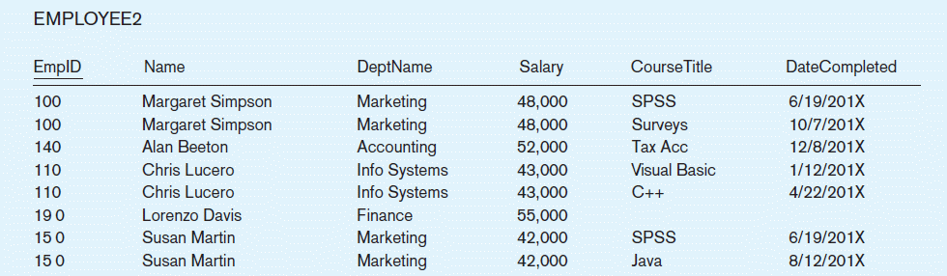
Example–Figure 4-2b
Question–Is this a relation?
Answer–Yes: Unique rows and no multivalued attributes
Question–What’s the primary key?
Answer–Composite: EmpID, CourseTitle
Notes:
Insertion–can’t enter a new employee without having the employee take a class
Deletion–if we remove employee 140, we lose information about the existence of a Tax Acc class
Modification–giving a salary increase to employee 100 forces us to update multiple records

Slide 6
Anomalies in this Table
Insertion–can’t enter a new employee without having the employee take a class
Deletion–if we remove employee 140, we lose information about the existence of a Tax Acc class
Modification–giving a salary increase to employee 100 forces us to update multiple records
Why do these anomalies exist?
  Because there are two themes (entity types) in this one relation. This results in data duplication and an unnecessary dependency between the entities
Notes:
Why do these anomalies exist?
Because there are two themes (entity types) in this one relation. This results in data duplication and an unnecessary dependency between the entities
The entities are employee and courses

Slide 7
Functional Dependencies and Keys
Functional Dependency: The value of one attribute (the determinant) determines the value of another attribute
Candidate Key:
  A unique identifier. One of the candidate keys will become the primary key
    E.g. perhaps there is both credit card number and SS# in a table…in this case both are candidate keys
  Each non-key field is functionally dependent on every candidate key
Notes:
To solve that problem in a logical way, we use Functional dependency.
The value of one attribute determines the other.
In this process we define keys are could become a primary key. We call them candidate keys. Unique identifier.
For a example SS# and Credit card numbers are candidate keys

Slide 8
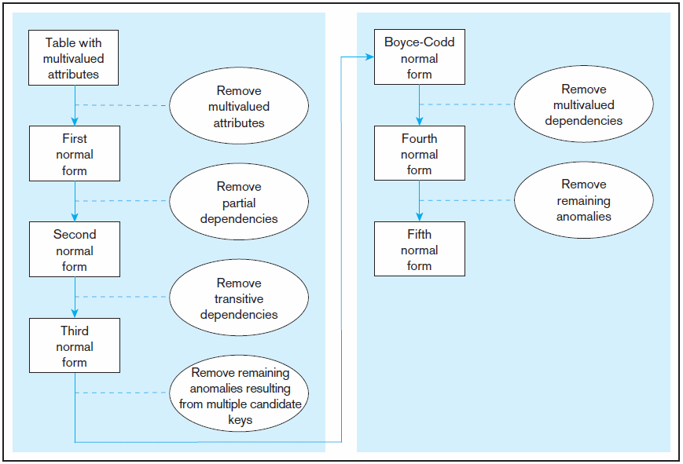
Figure 4.22 Steps in normalization
3rd normal form is generally considered sufficient
Notes:
Here are the steps to create normalizations:
1NF – remove multivalued attribute… Employee Skill for example
2NF – remove partial dependency
3NF – remove transitive dependencies
After 3NF it is typically not used. One interview question, you will often hear is “ Which Normal form do you normalize your database” The answer is third normal form.

Slide 9
First Normal Form
No multivalued attributes
Every attribute value is atomic
Fig. 4-25 is not in 1st Normal Form (multivalued attributes) ➔ it is not a relation
Fig. 4-26 is in 1st Normal form
All relations are in 1st Normal Form
Notes:
First normal forms, really what we are checking is that that there is no multivalued attribute, and values are atomic

Slide 10
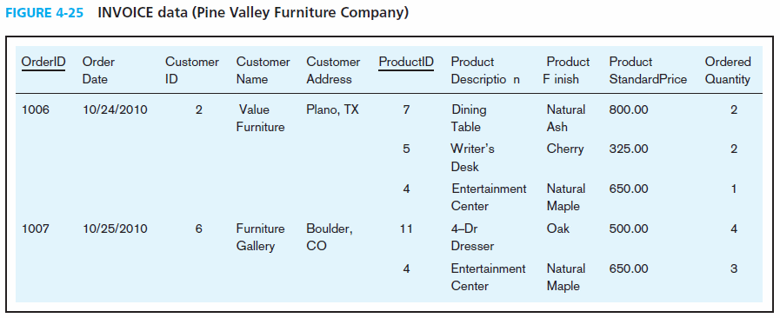
Table with multivalued attributes, not in 1st normal form
Note: this is NOT a relation
Notes:
This is not a relation. Orders -> customers -> products
This is not a relashion

Slide 11
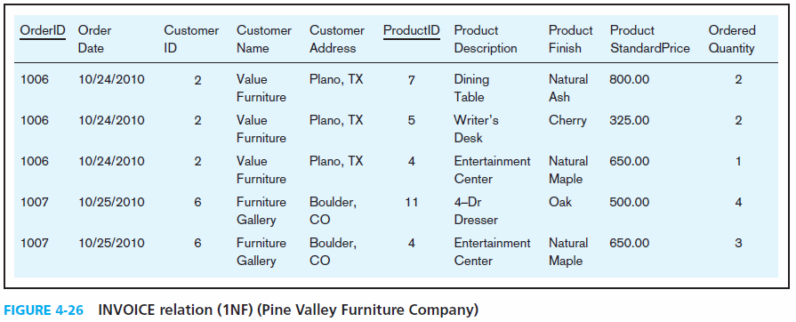
Table with no multivalued attributes and unique rows, in 1st normal form
Note: this is a relation, but not a well-structured one
Notes:
Now that the values are filled in, It is a relation -> but a bad one:
Insertion–if new product is ordered for order 1007 of existing customer, customer data must be re-entered, causing duplication
Update–changing the price of product ID 4 requires update in multiple records

Slide 12
Anomalies in this Table
Insertion–if new product is ordered for order 1007 of existing customer, customer data must be re-entered, causing duplication
Deletion–if we delete the Dining Table from Order 1006, we lose information concerning this item's finish and price
Update–changing the price of product ID 4 requires update in multiple records
Why do these anomalies exist?
  Because there are multiple themes (entity types) in one relation. This results in duplication and an unnecessary dependency between the entities

Slide 13
Second Normal Form
1NF PLUS every non-key attribute is fully functionally dependent on the ENTIRE primary key
  Every non-key attribute must be defined by the entire key, not by only part of the key
  No partial functional dependencies
Notes:
Every non-key attribute is depended on the entire primary key ( primary key could be one simple of composite)
You don’t want partial dependencies.

Slide 14
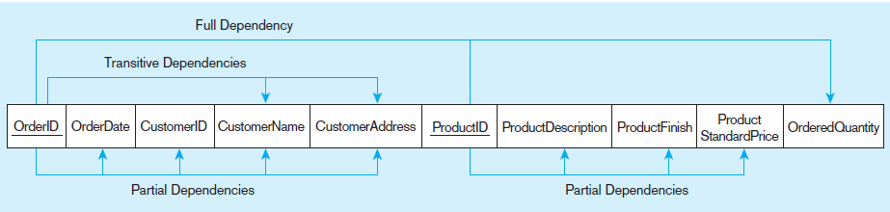
Figure 4-27 Functional dependency diagram for INVOICE
OrderID ➔ OrderDate, CustomerID, CustomerName, CustomerAddress
CustomerID ➔ CustomerName, CustomerAddress
ProductID ➔ ProductDescription, ProductFinish, ProductStandardPrice
OrderID, ProductID ➔ OrderQuantity
Therefore, NOT in 2nd Normal Form
Notes:
Partial dependency -> it looks like they are partially dependent on order ID
Transitive dependency -> attribute which depends on a key and a key depends on another

Slide 15
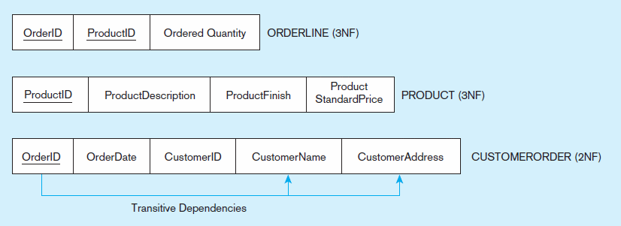
Figure 4-28 Removing partial dependencies
Getting it into Second Normal Form
Partial dependencies are removed, but there are still transitive dependencies

Slide 16
Third Normal Form
2NF PLUS no transitive dependencies (functional dependencies on non-primary-key attributes)
Note: This is called transitive, because the primary key is a determinant for another attribute, which in turn is a determinant for a third
Solution: Non-key determinant with transitive dependencies go into a new table; non-key determinant becomes primary key in the new table and stays as foreign key in the old table

Slide 17
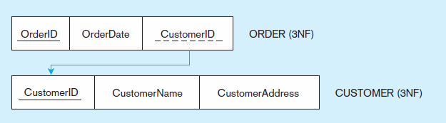
Figure 4-29 Removing partial dependencies
Getting it into Third Normal Form
Transitive dependencies are removed

Slide 18
Interview Question
Question: How do you normalize your database in a transactional environment, and describe the normalization steps?
Transactional systems are typically normalized in the 3NF:
  1FN – remove multi-valued attributes
  2NF – remove partial dependencies
  3NF – remove transitive dependencies
That questions pertains only to transactional system. In Datawarehouse, analytical systems you don’t normalize

Slide 19
Merging Relations
View Integration–Combining entities from multiple ER models into common relations
Issues to watch out for when merging entities from different ER models:
  Synonyms–two or more attributes with different names but same meaning
  Homonyms–attributes with same name but different meanings
  Transitive dependencies–even if relations are in 3NF prior to merging, they may not be after merging
  Supertype/subtype relationships–may be hidden prior to merging
Notes:
In large organizations, with complex projects you may have several folks contributing to design:
Need to watch for
Synonyms, Homonyms
Transitive dependencies,
Transitive dependencies

Slide 20
Enterprise Keys
Primary keys that are unique in the whole database, not just within a single relation
Corresponds with the concept of an object ID in object-oriented systems
Notes:
One way to solve that problem is to create enterprise keys

Slide 21
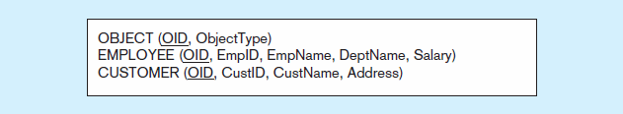
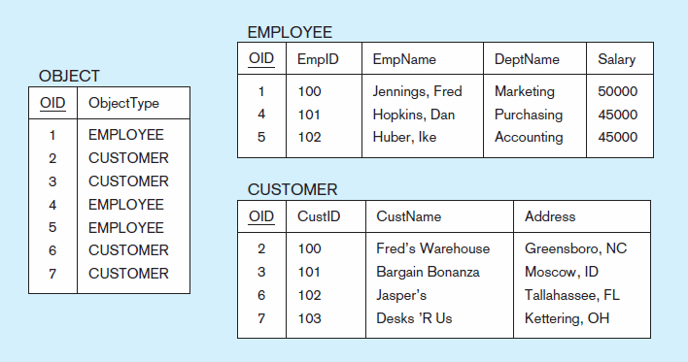
Figure 4-31 Enterprise keys
a) Relations with enterprise key
b) Sample data with enterprise key

Slide 22
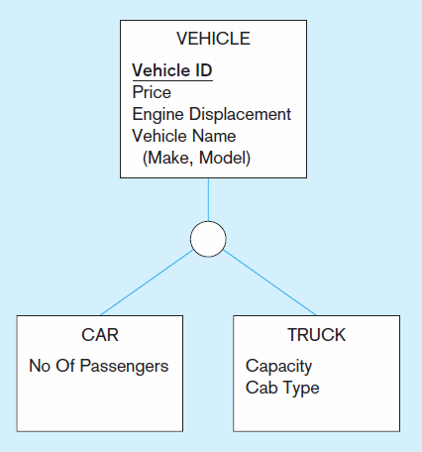
Transform the diagram into a relational schema that
shows referential integrity constraints
II. For each relation, diagram the functional dependencies
III. If any of the relations are not in 3NF, transform them
to 3NF.

Slide 23
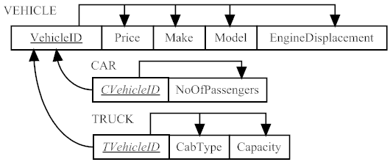
Solution

Slide 24
For each of the following relations, indicate the normal form for that relation. If the relation is not in third normal form, decompose it into 3NF relations. Functional dependencies (other than those implied by the primary key) are shown where appropriate.
CLASS(CourseNo, SectionNo)
CLASS(CourseNo, SectionNo, Room)
CLASS(CourseNo, SectionNo, Room, Capacity)
  [FD: Room →Capacity]
CLASS(CourseNo, SectionNo, CourseName, Room, Capacity)
  [FD: CourseNo →CourseName; FD: Room →Capacity]
Notes:
Solution
a)3NF
b)3NF
c) 2NF ( it still has transitive dependency. Capacity is dependent on Room and Room is dependent on CourseNo)
Solution in 3NF:
CLASS (CourseNo, SectionNo, Room)
ROOM (Room, Capacity)
d)1NF … Why: We know from above that it has transitive dependency, so it cannot be in 3NF. What about partial dependency? Yes, because CourseName is functionally dependent of CourseNo.
Solution in 3NF:
COURSE (CourseNo, CourseName)
CLASS (CourseNo, SectionNo, Room)
ROOM (Room, Capacity)

